Slide 1
Impact of Fraud Detection Model on Business
By:
Shenaz Rahaman

Slide 2
Agenda
Objective
Background
Root Cause Analysis
Key Findings
Recommendations
Impact on Business
Appendix:
Data Sources
Data Methodology
Data Model Assumptions

Slide 3
Objective
Detect fraudulent transactions.
Provide recommendations to the stakeholders.
Analyze the impact on business.

Slide 4
Background
The Federal Trade Commission (US) has estimated that around 10 million people become victims of credit card theft each year.
Credit card companies lose close to $50 billion per year to fraud.
Banking fraud leads to substantial loss in finances, trust and credibility for both banks and customers.

Slide 5
Credit Card Fraud
Inclusive term for fraud committed using a payment card, such as credit or debit card.
Types:
Card-present fraud - Use of stolen/lost cards
Card-not-present fraud - ATM skimming at various POS terminals
This often leads to Transaction fraud, Account takeover, Identity theft, etc.

Slide 6
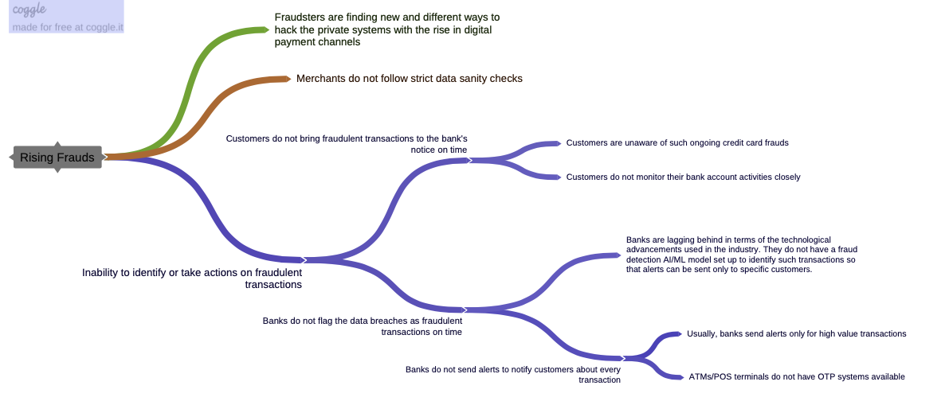
Root Cause Analysis
The most significant reason for rising transaction frauds is the inability to identify and prevent them.

Slide 7
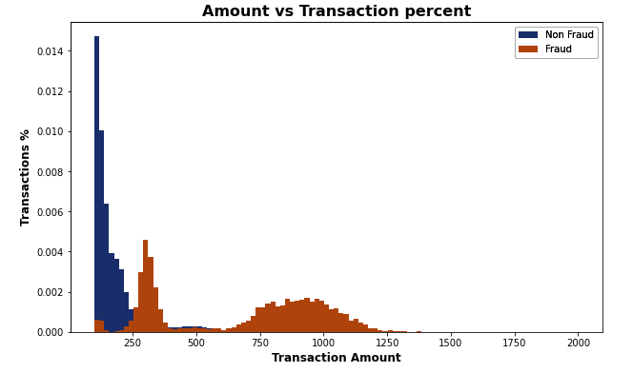
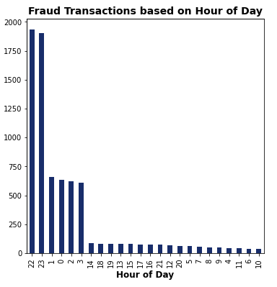
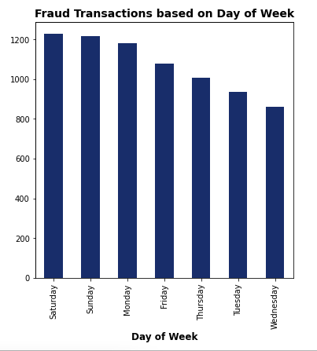
Reasons for delayed reporting of frauds
Overall transaction amount lies below $1500. | Occurs during non-peak and odd hours of the day (10pm-3am). | Unnoticed transactions over the weekends.

Slide 8
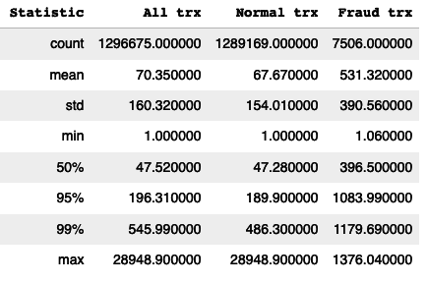
Insights on Transaction Amount
Average amount of fraud transactions are relatively higher than normal transactions:
Fraud: 531.32
Normal: 67.67
Maximum amount of fraud transactions are significantly lower than normal transactions:
Fraud: 1376.04
Normal: 28948.90

Slide 9
Other Significant Features
Age - About 50% of the transactions are done by people in the age group of 33 to 57 years.
Category - Overall highest number of transactions are in gas_transport but, most fraudulent transactions are in grocery_pos.
Transaction Period - Highest number of fraudulent transactions are observed in December.

Slide 10
Recommendations
Deploy a fraud detection model with a second layer of authentication service by banks for flagged transactions.
Issue cards using chip identification to decrease the possibility of card skimming.
Reviewing charges regularly and reporting unauthorized transactions immediately by cardholders.
Collaborate and share information about known fraudsters and emerging threat vectors among industries.

Slide 11
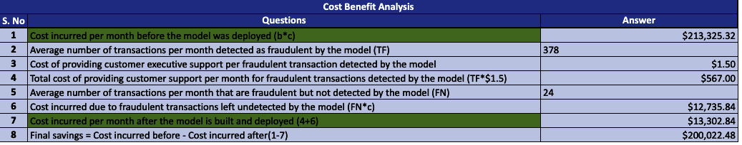
Impact on Business
Implementation of the fraud detection model will help the business to save around $200K on a monthly basis.

Slide 12
Appendix - Data Sources
The dataset contains historical transactional data of around 1,000 cardholders with a pool of 800 merchants from 1 Jan 2019 to 31 Dec 2020.
Includes:
Customer demographics - gender, job, age, street, city, state, zip.
Transaction information - transaction number, transaction timestamp, credit card number.

Slide 13
Appendix - Data Methodology
The CRoss Industry Standard Process for Data Mining (CRISP-DM) framework was used to analyze the transactional data and implement a suitable solution. This included:
Structured problem solving method to understand and determine the root cause of the business problem.
Data analysis, cleaning, handling imbalance, scaling to choose the significant features for building the final model.
Logistic regression, decision tree, random forest and gradient boosting modelling techniques to solve the classification problem. Recall score was chosen as the suitable metric to capture the most fraudulent transactions.

Slide 14
Appendix - Data Model Assumptions
The original dataset was segmented into train and test data to maintain real time scenario:
fraudTrain.csv - used as historical dataset for analysis, modelling and validation;
fraudTest.csv - used as unseen dataset for final model evaluation.
The columns ‘job’ and ‘merchant’ were dropped as no significant conclusion could be drawn from them.
The model deployment cost is not included while gauging the long term benefits of putting this model into practice.

Slide 15
Thank You.

